Slide 1
WebAPI Introduction

Slide 2
Contents
What is ASP.NET Web API?
What are the RESTful services?
What is the difference between REST and SOAP?
What are the Differences between the WCF Service and Web API Service? When to choose one over the other?
Why Do I need to choose ASP.NET WEB API?
What is the difference between WCF and WEB API and WCF REST and Web Service?
What is the difference between ASP.NET MVC and ASP.NET Web API?

Slide 3
What is an API?
• Methods to access data and workflow from an application without using the application itself

Slide 4
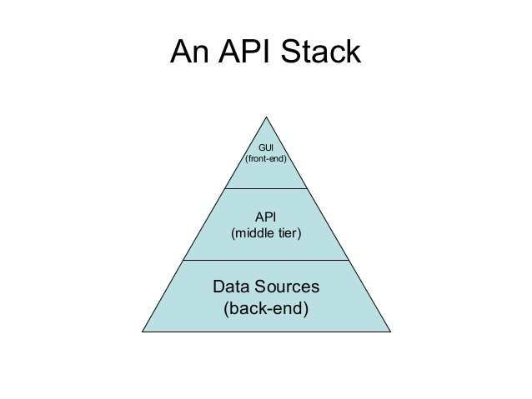
An API Stack

Slide 5
ASP.NET Web API
The term API stands for “Application Programming Interface“. ASP.NET Web API is a framework, provided by Microsoft, which makes it easy to build Web APIs, i.e. HTTP based services. The ASP.NET Web API is an ideal platform for building Restful services on the top of the .NET Framework. These Web API services can be consumed by a variety of clients such as
Browsers
Mobile applications
Desktop applications
IOTs, etc.
we can develop both Restful and Non-Restful Web Services using the ASP.NET Web API framework. But mostly this framework is used to create RESTful services.

Slide 6
What are the RESTful services?
REST stands for Representational State Transfer. REST was first introduced in the year 2000.
The REST is actually an architectural pattern that is basically used for creating Web API’s which uses HTTP as the communication method.
This REST architectural pattern specifies a set of constraints and those constraints a system should follow to be considered as a Restful Service

Slide 7
REST Constraints
Client-Server Constraint:
The Client-Server Constraint is the first constraint of Rest Architectural Pattern.
This constraint specifies that a Client sends a request to the server and the server sends a response back to the client.
This separation of concerns supports the independent development of both client-side logic and server-side logic.

Slide 8
Stateless Constraint:
The next constraint of Rest Architectural Pattern is the Stateless Constraint.
The Stateless Constraint specifies that the communication between the client and server should be stateless between the requests.
That means we should not be storing any information about the client on the server.
The request that comes from the client should contain all the necessary information that is required for the server to process that request which will ensure that each request coming from the client will be treated independently by the server

Slide 9
Cacheable Constraint:
The next Constraint is Cacheable Constraint. Some of the master data provided by the server like a list of countries, or list of cities or list of the department in a company does not change that often.
The Cacheable Constraint states that let the client decide how long this data is good for so that the client does not need to come back to the server again and again for the same data.

Slide 10
Uniform Interface:
The Uniform Interface constraint defines an interface between the client and the server.
To understand the uniform interface constraint, we need to understand what a resource is and the
HTTP verbs – GET, PUT, POST and DELETE.
From the REST API Point of view, the resources typically represent the data entities such as Product, Student, Customer, etc.
The HTTP verb such as GET, POST, PUT, and DELETE which is sent with each request from the client tells the API what to do with the resource. Each resource in a REST API is identified by a unique URI (Uniform Resource Identifier).

Slide 11
Resource | Verb | Outcome
/Employees | GET | Gets list of employees
/Employee/1 | GET | Gets employee with Id = 1
/Employees | POST | Creates a new employee
/Employee/1 | PUT | Updates employee with Id = 1
/Employee/1 | DELETE | Deletes employee with Id = 1

Slide 12
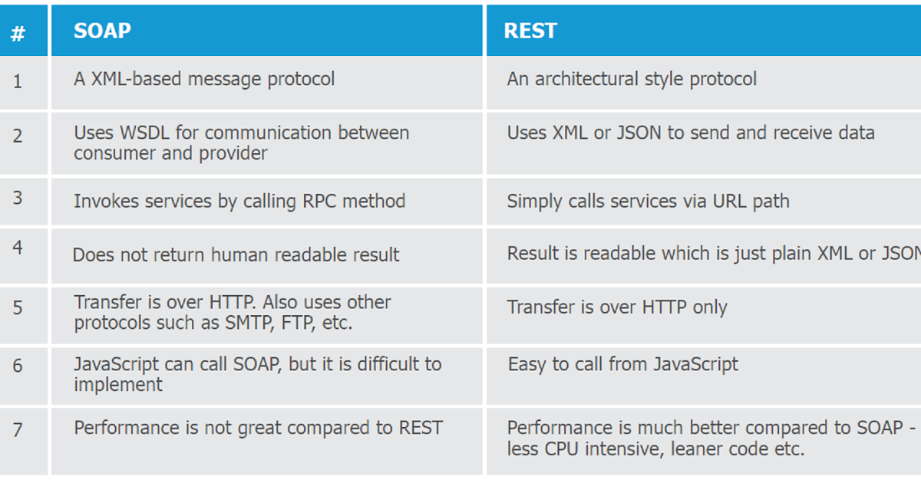
difference between REST and SOAP?

Slide 13
Differences between the WCF Service and Web API Service? When to choose one over the other?
The term WCF stands for Windows Communication Foundation and it is one of the most popular choices available in .NET Framework for creating the REST services.
The problem with WCF is that we need to do a lot of configuration to turn a WCF service into a REST service.
So, if you want to develop a REST service nowadays, then the first and most preferable choice is ASP.NET Web API, which is specifically designed for this purpose i.e. to build REST Services.

Slide 14
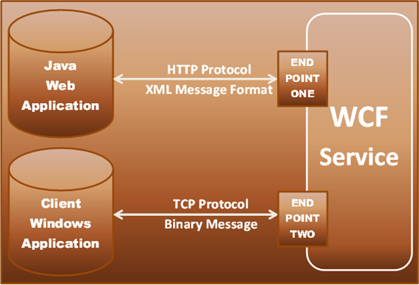
Then the question that comes to our mind when should we use WCF?

Slide 15
The WCF is basically used to develop the services which are transport/protocol independent.
For example, you want to build a single service which can be consumed by 2 different clients – Let’s say, a Java client and .NET client.
The Java client wants the protocol (transport protocol) to be HTTP and he also wants the message to be in XML format for interoperability,
whereas the .NET client wants the protocol (transport protocol) to be TCP and he wants the message to be in the binary format for performance.
If this is the scenario, then WCF is the right choice. What you need to do here is, just develop a single WCF service, and then expose 2 endpoints one for each client (i.e. one endpoint for the Java client and the other endpoint for the .NET client).

Slide 16
The thing that you need to remember is that you can use the WCF to create the REST services. The problem is it’s bit more configuration to turn a WCF Service to WCF Rest Service. So, if you are stuck with the .NET Framework 3.5 or you have an existing SOAP service and you want to add REST to reach more clients, then use WCF

Slide 17
Why Do I need to choose ASP.NET WEB API?
Nowadays, a web application is not sufficient or enough to reach all its customers. Peoples are becoming very smart; they are using different types of devices such as mobile, iPhone, tablets, etc. in their daily life. These devices are having a lot of apps which makes their life easy. In simple words, we can say that we are moving towards the apps world from the web.
So, if we want to expose our data (business data) to the browsers as well as to all these modern devices apps in a fast, secure and simple way, then we should have an API that should be compatible with browsers as well as all these modern devices.
The ASP.NET WEB API is a great framework for building HTTP services that can be consumed by a broad range of clients including browsers, mobiles, iPhones, and tablets.

Slide 18
difference between WCF and WEB API and WCF REST and Web Service?
The .NET framework has a number of technologies that allow us to create HTTP services such as Web Service, WCF, WCF Rest and now WEB API.
Web Service:
The Web Service is based on SOAP and it returns the data in XML format.
It supports only the HTTP protocol.
Web Service is not an open source but it can be consumed by any client who understands XML.
It can only be hosted on IIS.

Slide 19
WCF:
WCF is also based on SOAP and it also returns the data in the form of XML.
Unlike Web service, WCF supports different types of protocols (transport protocol) such as TCP, Named Pipes, HTTP, HTTPS, and MSMQ.
The main problem with WCF service it required lots of configuration which is a headache for a developer.
Like Web Service, WCF is also not open source but it can be consumed by any client who understands XML.
WCF can be host within in the application or on IIS or using window service.

Slide 20
WCF Rest
To use a WCF service as WCF Rest service we have to enable webHttpBindings.
WCF Rest supports the HTTP verbs such as GET and POST by using the [WebGet] and [WebInvoke] attributes respectively.
To use other HTTP verbs you have to do some configuration in the IIS so that it will accept the request of that particular verb on .svc file
It supports different data formats such as XML, JSON, and Atom format.

Slide 21
WEB API
The Web API Framework is a new framework that is basically used for developing HTTP based services in easy and simple way.
Unlike WCF Rest Service, it uses the full HTTP features such as URIs, request/response headers, caching, versioning, and various data formats.
The ASP.NET Web API also supports most of the MVC features such as routing, controllers, actions, filter, model binders, IOC container, dependency injection, unit testing which makes it more simple and robust.
WEB API Services can be hosted on IIS or within the application
The Responses in Web API Services are formatted by MediaTypeFormatter into JSON, XML or any custom format you want.

Slide 22
difference between ASP.NET MVC and ASP.NET Web API?
ASP.NET MVC is used to create web applications that return both views and data but ASP.NET WEB API is used to create rest full HTTP services with an easy and simple way that returns only data, not view.
WEB API helps to build REST-full services over the .NET Framework and it also supports content-negotiation(it’s about deciding the best response format data that could be acceptable by the client. it data format may be JSON, XML, ATOM or any other custom formatted data) which are not in MVC.
WEB API also takes care of returning data in a particular format like JSON, XML or any other based upon the Accept header in the request. The ASP.NET MVC Framework can return data only in JSON format using the JsonResult return type.
In WEB API the request is mapped to the actions based on HTTP verbs but in MVC it is mapped to the action name.
We can mix WEB API and MVC controller in a single project to handle advanced AJAX requests which may return data in JSON, XML or any others format and build a full-blown HTTP service. Typically, this will be called WEB API self-hosting.
Moreover, WEB API is lightweight architecture and except for the web application, it can also be used with smartphone apps.

Slide 23
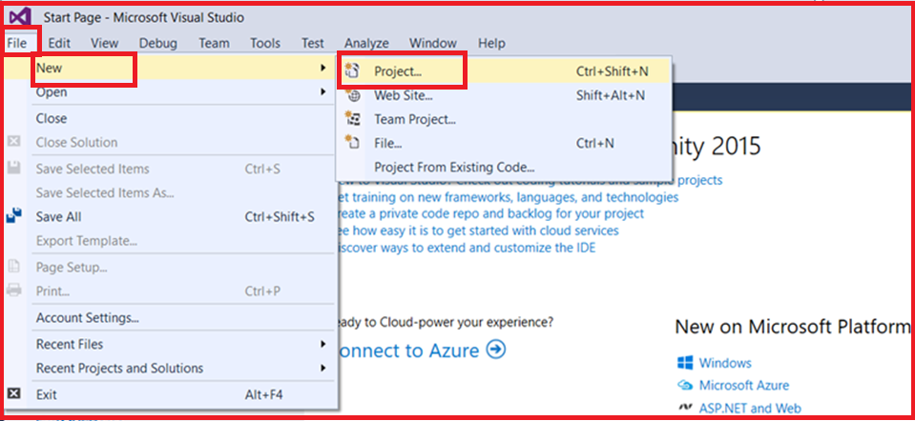
Creating Web API Application using Visual Studio

Slide 24
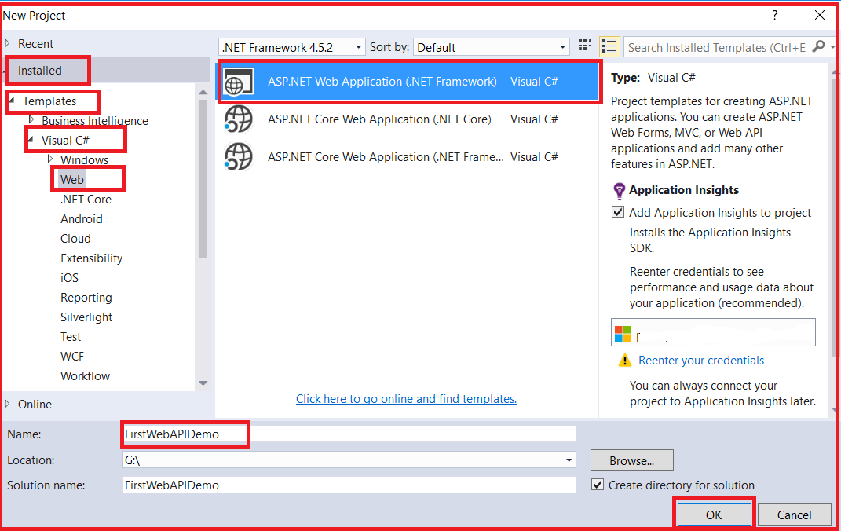

Slide 25
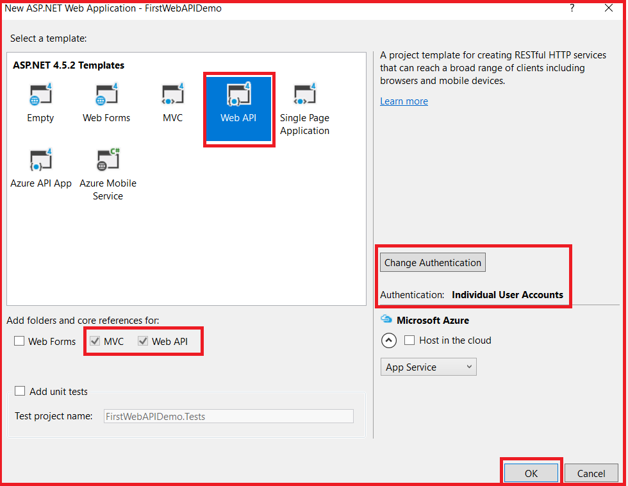

Slide 26
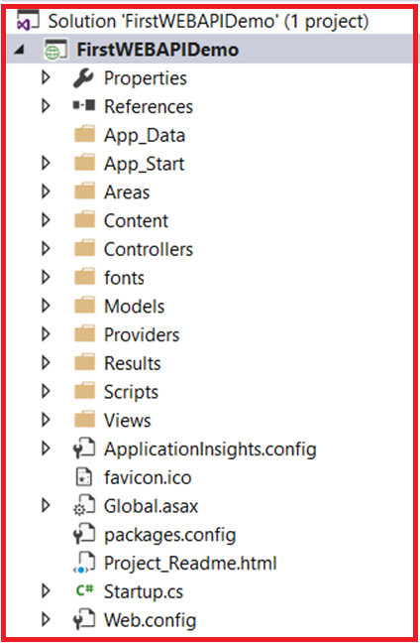
Understanding the Folder Structure of Web API Application:

Slide 27
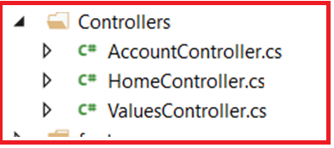
Here, we have separate folders for Models, Views, and Controllers and moreover, within the Controllers folder, we have both MVC as well as Web API Controller as shown in the below image.

Slide 28
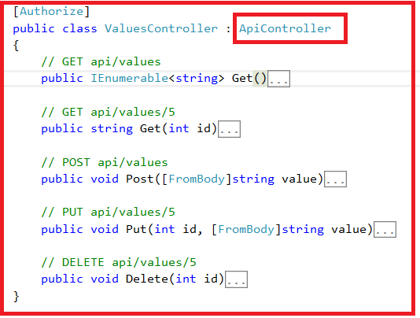
The important thing to keep in mind is that the Web API Controllers are
different from MVC Controllers. In our example, the ValuesController is WebAPI Controller.

Slide 29
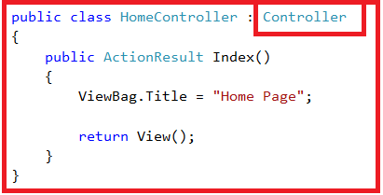
If you observe the above ValuesController Class, then you will see that it inherits from the ApiController class which is present in sytem.web.http namespace.
Further, if you notice that the HomeController class is an MVC Controller, which is inherited from the Controller class that is present in System.Web.Mvc namespace as shown in the below image.

Slide 30
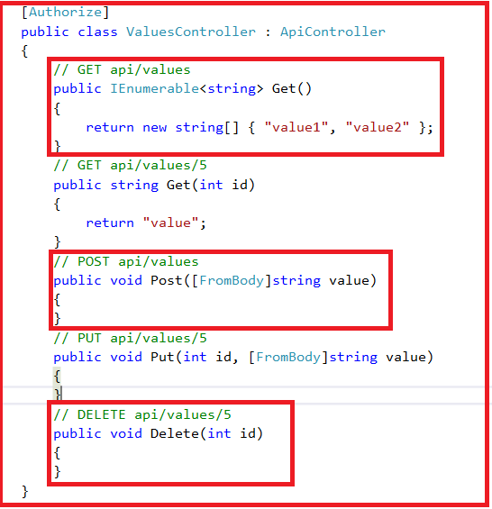
Notice that in the ValuesController we have methods such as Get, Put, Post and Delete that map to the HTTP verbs GET, PUT, POST and DELETE respectively as shown in below image.

Slide 31
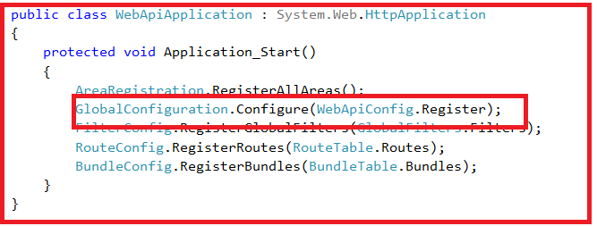
We have 2 overloaded versions of the Get() method – One method without any parameters and the other one with the id parameter. Both of these methods respond to the GET HTTP verb depending on whether the id parameter is passed or not in the URL.
Now let’s look at the default route for our Web API project. We have the Application_Start() method within the Global.asax file. This method is executed when the application starts for the first time. In the Application_Start() method we have the configuration for Filters, Bundles, etc. as shown below.

Slide 32
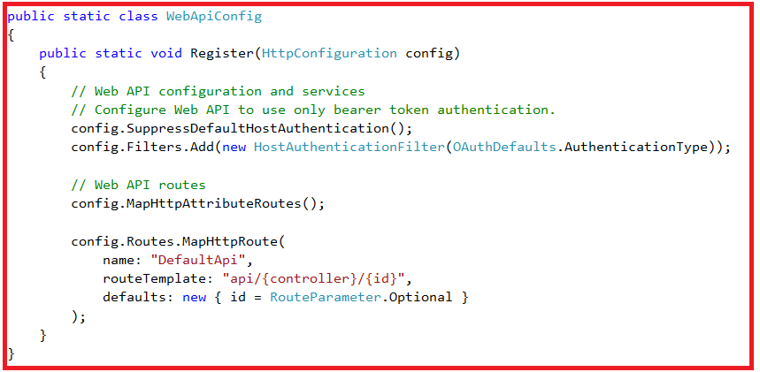

Slide 33
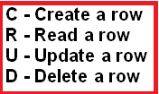
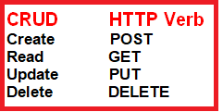
Let’s discuss about POST, PUT and DELETE.
In a database table row, we can perform the following 4 actions
From the ASP.NET Web API point of view, these 4 actions correspond to GET, POST, PUT and DELETE verb as shown below

Slide 34
HTTP request and response
Request Header:
When a client sends the request to the server, the request contains a header and a body.
The header of the request contains some additional information such as what type of response the client required.
For example, the client wants the response to be in XML or JSON format.

Slide 35
Request Body
The Request Body contains the data that you want to send to the server.
For example, a POST request contains the data in the Request Body for the new item that you want to create. The data may be in the form XML or JSON

Slide 36
Response Body
The Response Body contains the data that is sent as a response from the server.
For example, if you request a specific employee, then the response body includes the employee details either in the form of XML or JSON.

Slide 37
Response Status codes
The Response Status Codes are the HTTP status codes that will specify the status of the request.
The most common status codes are 200/OK, 204/No Content, 500/Internal Server Error, 404/Not Found.

Slide 38
public class ValuesController : ApiController
{
static List<string> strings = new List<string>()
{
"value0", "value1", "value2"
};
// GET api/values
public IEnumerable<string> Get()
{
return strings;
}
// GET api/values/5
public string Get(int id)
{
return strings[id];
}
// POST api/values
public void Post([FromBody]string value)
{
strings.Add(value);
}
// PUT api/values/5
public void Put(int id, [FromBody]string value)
{
strings[id] = value;
}
// DELETE api/values/5
public void Delete(int id)
{
strings.RemoveAt(id);
}
}

Slide 39
At the moment the Post(), Put() and Delete() methods in the ValuesController are returning void. That is the reason why we are getting the status code 204 No Content. In ASP.NET Web API, an action method that returns void will send the status code 204 No Content by default, but we can control this behavior

Slide 40
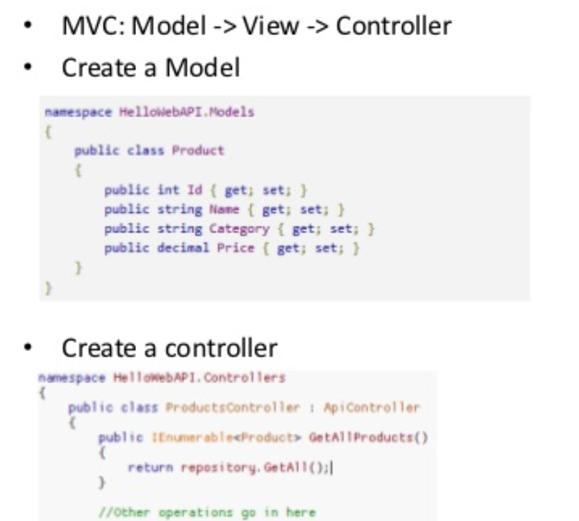

Slide 41
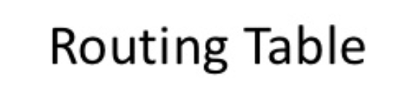
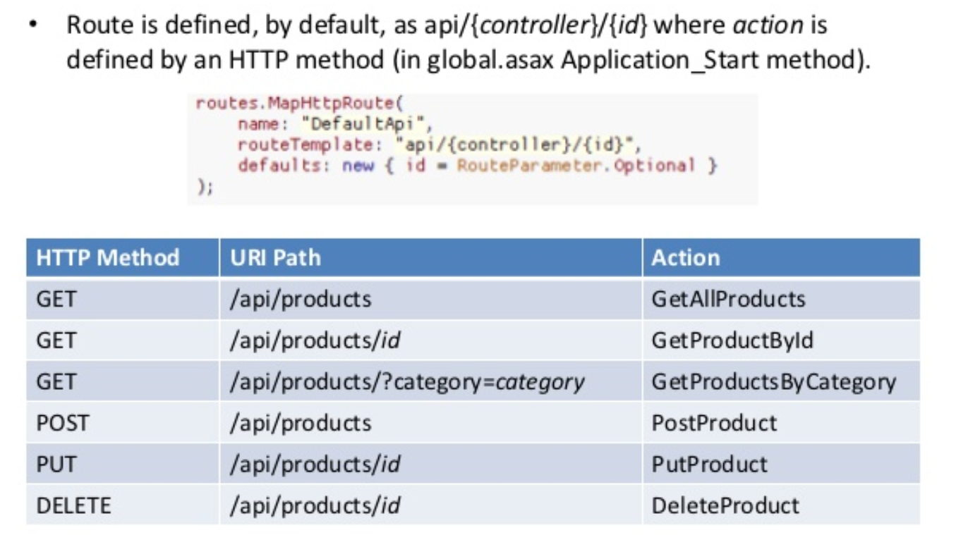

Slide 42
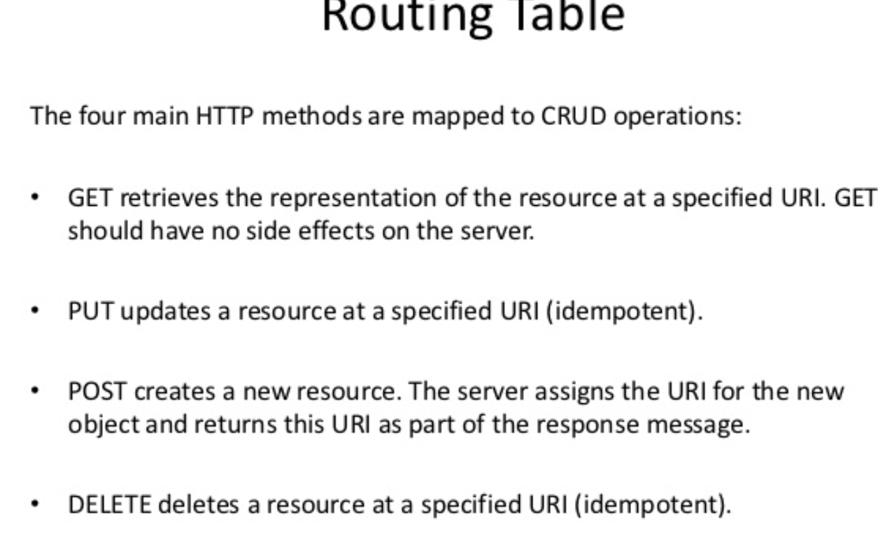

Slide 43
Idempotent
From a RESTful service standpoint, for an operation (or service call) to be idempotent, clients can make that same call repeatedly while producing the same result. In other words, making multiple identical requests has the same effect as making a single request.

